Slide 1

Getting Started with MATLAB
01. An Introduction
Vahid Naeini
E-mail: naeini.v@gmail.com

Slide 2
MATLAB?
MATrix LABoratory
Initial release: 1984 (31 years ago)
Written in: C, C++, Java, MATLAB
Getting Started with MATLAB / 01. An Introduction / V.Naeini

Slide 3
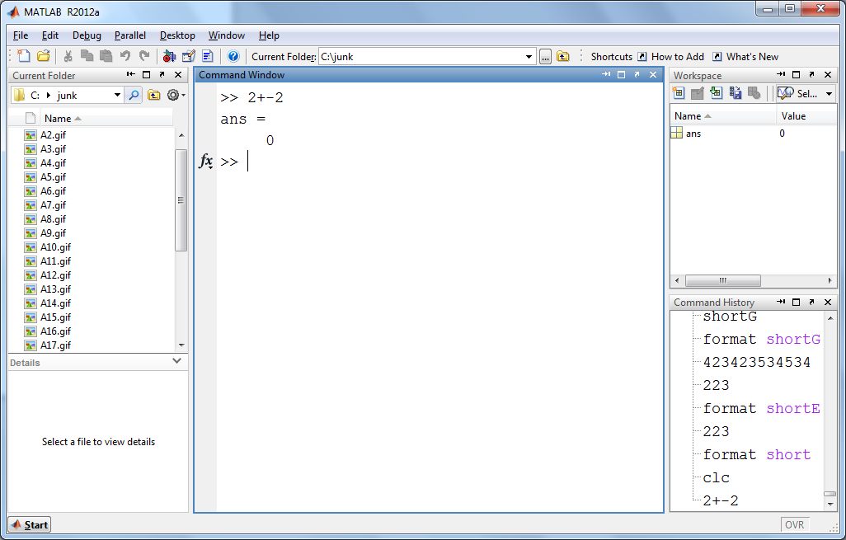
MATLAB Window (Default)
Current Folder Directory
Command Window
Workspace
Current Folder Contents
History
Item details (Files, M-codes, etc. )
Getting Started with MATLAB / 01. An Introduction / V.Naeini

Slide 4
“Help me, get my feet back on the ground”
The Beatles
Prompt >>
>> help
>> help help
>> help sin
>> lookfor atan
>> doc %opens documentation
Getting Started with MATLAB / 01. An Introduction / V.Naeini

Slide 5



Wanna more Help?
http://www.mathworks.com/matlabcentral/fileexchange/
http://stackoverflow.com/questions/tagged/matlab
OR … Google it …
Getting Started with MATLAB / 01. An Introduction / V.Naeini

Slide 6
Variables ‘n’ Assignment Statements
>> mynum = 6
!!! 6 = mynum
res = 9 e 2; %semicolons
mynum = mynum + 1
Getting Started with MATLAB / 01. An Introduction / V.Naeini

Slide 7
Variables Names
begin with a letter of the alphabet
>> namelengthmax %max length of var name
MATLAB is cAse-SeNSiTIvE !
Reserved words, or keywords: cannot be used as variable names.
Names of built-in functions can, but should not, be used as variable names.
Getting Started with MATLAB / 01. An Introduction / V.Naeini

Slide 8
Data Types
Two main types: Double and Single
Double stores larger numbers than the single type.
Integer Types: int8/uint8, int16/uin16, …
How to check max and min assigned num:
>> intmin(‘int8’)
>> intmax(‘uint64’)
Getting Started with MATLAB / 01. An Introduction / V.Naeini

Slide 9
Data Types
char : stores characters
>> numequiv = double('a')
>> char(97)
>> numequiv = double('a');
>> char(numequiv + 1)
>> 'a' + 2
Getting Started with MATLAB / 01. An Introduction / V.Naeini

Slide 10
Data Types
logical: only 2 values, true & false
Check variables with “whos” and “who”
Clear variable(s) →
>> clear
Getting Started with MATLAB / 01. An Introduction / V.Naeini

Slide 11
Numerical Expressions
>> 2 * sin(1.4)
format long
format short
Other formats: short (default), long, shortEng, longEng, bank, rat, hex
Getting Started with MATLAB / 01. An Introduction / V.Naeini

Slide 12
Operations
+ addition
- negation, subtraction
* multiplication
/ division (divided by e.g. 10/5 is 2)
\ division (divided into e.g. 5\10 is 2)
^ exponentiation (e.g. 5^2 is 25)
Getting Started with MATLAB / 01. An Introduction / V.Naeini

Slide 13
Operator Precedence Rules
( ) parentheses
^ exponentiation
- negation
* / \ all multiplication and division
+ - addition and subtraction
In a group of operators with same precedency, left operators are prior.
Getting Started with MATLAB / 01. An Introduction / V.Naeini

Slide 14
Practice ☺
Think what the result would be, then double check with MATLAB (5 minutes)
1\2
-5^2
(-5) ^ 2
10-6/2
5*4/2*3
2-2*2+2*2^2
Getting Started with MATLAB / 01. An Introduction / V.Naeini

Slide 15
Logical Expressions
> greater than
< less than
>= greater than or equals
<= less than or equals
== equality
~= inequality
Getting Started with MATLAB / 01. An Introduction / V.Naeini

Slide 16
Logical Expressions
>> 3 < 5
>> 2 > 9
>> 'a' < 'c'
Getting Started with MATLAB / 01. An Introduction / V.Naeini

Slide 17
Logical Operators
|| OR
&& AND
~ NOT
>> 2<4 || 'a' == 'c'
Getting Started with MATLAB / 01. An Introduction / V.Naeini

Slide 18
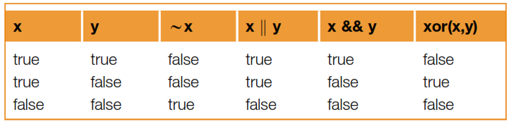
Logical Operators
Getting Started with MATLAB / 01. An Introduction / V.Naeini

Slide 19
Operator Precedence Rules
Highest Precedence
Parentheses: ()
Power ^
unary: negation (-), not(~)
multiplication, division *, /, \
addition, subtraction +,-
relational <, <=, >, >=, ==, ~=
and &&
or ||
assignment =
Lowest Precedence
Getting Started with MATLAB / 01. An Introduction / V.Naeini

Slide 20
Question ?
What would be the value of the expression
>> 3 < x < 5
if the value of x is 4? What if the value of x is 7?
Answer:
>> ans =
1
Getting Started with MATLAB / 01. An Introduction / V.Naeini

Slide 21
Practice ☺
Think about what would be produced by the following expressions, and then type them in to verify your answers (10 minutes)
3==5 + 2
'b' < 'a' + 1
10 > 5 + 2
(10 > 5) + 2
'c' == 'd' - 1 && 2 < 4
'c' == 'd' - 1 || 2>4
xor('c' == 'd' - 1, 2 > 4) %Optional
xor('c' == 'd' - 1, 2 < 4) %Optional
10 > 5> 2
Getting Started with MATLAB / 01. An Introduction / V.Naeini

Slide 22
Basic Functions
>> rem(13,5)
>> mod(13,5)
>> sign(-5)
>> sqrt(4)
>> nthroot(64,3)
>> exp(5)
Getting Started with MATLAB / 01. An Introduction / V.Naeini

Slide 23
Practice ☺
1. Use the help function to find out what the rounding functions fix, floor, ceil, and round do.
(5 minutes)
2. Find the answer for these statements:
fix(4.23) fix(-3.75)
floor(3.98) ceil(3.98) round(3.98)
floor(-3.98) ceil(-3.98) round(-3.98)
Getting Started with MATLAB / 01. An Introduction / V.Naeini

Slide 24
Constants
pi pi number
i i = sqrt(-1)
j i
inf infinity
NaN not a number e.g. 0/0
Getting Started with MATLAB / 01. An Introduction / V.Naeini

Slide 25
Constants
eps floating-point relative accuracy
>> eps(‘double’)
>> eps(‘single’)
intmax Largest value of specified integer type
>> intmax(‘uint16')
intmin Smallest value of specified integer type
>> intmax(‘int32')
Getting Started with MATLAB / 01. An Introduction / V.Naeini

Slide 26
Constants
realmax Largest positive floating-point number
>> realmax(‘double')
realmin Smallest positive normalized floating-point number
>> realmin(‘single')
Getting Started with MATLAB / 01. An Introduction / V.Naeini

Slide 27
Question ?
There is no built-in constant for e (2.718), so how can that value be obtained in MATLAB?
Answer:
>> exp(1)
Getting Started with MATLAB / 01. An Introduction / V.Naeini

Slide 28
Random Numbers
>> rand
rand returns a real number in the open interval (0, 1)
Getting Started with MATLAB / 01. An Introduction / V.Naeini

Slide 29
Question ?
Generate a random real number in the range from 4 to 9 !
Answer:
rand*(high-low)+low.
>> low = 4
>> high = 9
>> rand*(high-low) + low
Getting Started with MATLAB / 01. An Introduction / V.Naeini

Slide 30
Question ?
How to Generate a random integer?
Answer:
>> round(rand*10) % int in range [0 10]
>> round(rand*(high-low) + low)
>> randi([3,6])
Getting Started with MATLAB / 01. An Introduction / V.Naeini

Slide 31
Practice ☺
Generate a random
real number in the range (0,1)
real number in the range (0, 100)
real number in the range (20, 35)
integer in the inclusive range from 1 to 100
integer in the inclusive range from 20 to 35.
(5 minutes)
Getting Started with MATLAB / 01. An Introduction / V.Naeini

Slide 32
“Nothing can ever happen twice
In consequence the sorry fact is
That we arrive here improvise
And leave without a chance to practice”
Wisława Szymborska (1923–2012)
Polish poet, essayist, translator and
recipient of the 1996 Nobel Prize in Literature
Getting Started with MATLAB / 01. An Introduction / V.Naeini

